Slide 1
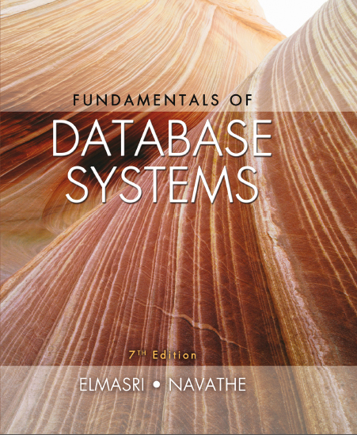
Fundamentals of Database Systems
Seventh Edition
Chapter 27
Introduction to Information Retrieval and Web Search
Copyright © 2016, 2011, 2007 Pearson Education, Inc. All Rights Reserved
Notes:
If this PowerPoint presentation contains mathematical equations, you may need to check that your computer has the following installed:
1) MathType Plugin
2) Math Player (free versions available)
3) NVDA Reader (free versions available)

Slide 2
27.1 Information Retrieval (I R) Concepts (1 of 4)
Information retrieval
Process of retrieving documents from a collection in response to a query (search request)
Deals mainly with unstructured data
Example: homebuying contract documents
Unstructured information
Does not have a well-defined formal model
Based on an understanding of natural language
Stored in a wide variety of standard formats

Slide 3
Information Retrieval (I R) Concepts (2 of 4)
Information retrieval field predates database field
Academic programs in Library and Information Science
R D B M S vendors providing new capabilities to support various data types
Extended R D B M S s or object-relational database management systems
User’s information need expressed as free-form search request
Keyword search query

Slide 4
Information Retrieval (I R) Concepts (3 of 4)
Characterizing an I R system
Types of users
Expert
Layperson
Types of data
Domain-specific
Types of information needs
Navigational search
Informational search
Transactional search

Slide 5
Information Retrieval (I R) Concepts (4 of 4)
Enterprise search systems
Limited to an intranet
Desktop search engines
Searches an individual computer system
Databases have fixed schemas
I R system has no fixed data model

Slide 6
Comparing Databases and I R Systems
Table 27.1 A comparison of databases and I R systems
Databases | I R Systems
Structured data | Unstructured data
Schema driven | No fixed schema; various data models (e.g., vector space model)
Relational (or object, hierarchical, and network) model is predominant | Free-form query models
Structured query model | Rich data operations
Rich metadata operations | Search request returns list or pointers to documents
Query returns data | Blank
Results are based on exact matching (always correct) | Results are based on approximate matching and measures of effectiveness (may be imprecise and ranked)

Slide 7
A Brief History of I R
Stone tablets and papyrus scrolls
Printing press
Public libraries
Computers and automated storage systems
Inverted file organization based on keywords and their weights as indexing method
Search engine
Crawler
Challenge: provide high quality, pertinent, timely information

Slide 8
Modes of Interactions in I R Systems
Primary modes of interaction
Retrieval
Extract relevant information from document repository
Browsing
Exploratory activity based on user’s assessment of relevance
Web search combines both interaction modes
Rank of a web page measures its relevance to query that generated the result set

Slide 9
Generic I R Pipeline (1 of 2)
Statistical approach
Documents analyzed and broken down into chunks of text
Each word or phrase is counted, weighted, and measured for relevance or importance
Types of statistical approaches
Boolean
Vector space
Probabilistic

Slide 10
Generic I R Pipeline (2 of 2)
Semantic approaches
Use knowledge-based retrieval techniques
Rely on syntactic, lexical, sentential, discourse-based, and pragmatic levels of knowledge understanding
Also apply some form of statistical analysis

Slide 11
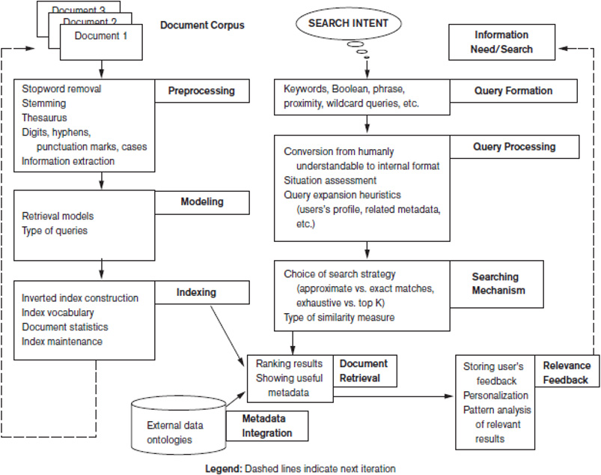
Figure 27.1 Generic I R Framework

Slide 12
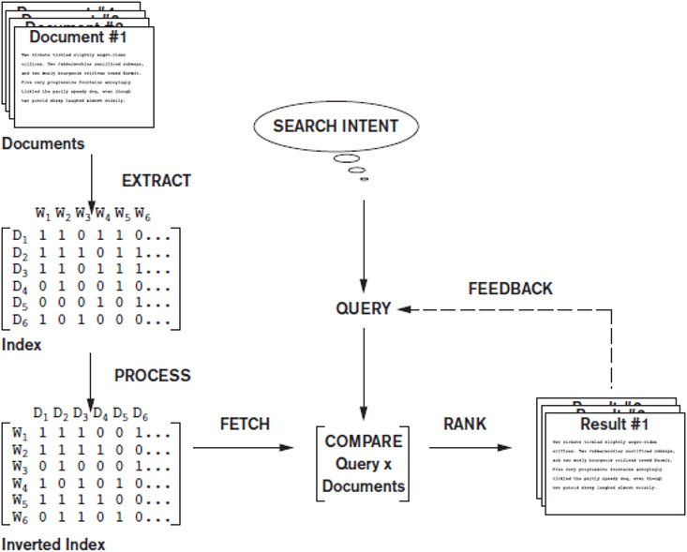
Figure 27.2 Simplified I R Process Pipeline

Slide 13
27.2 Retrieval Models (1 of 5)
Boolean model
One of earliest and simplest I R models
Documents represented as a set of terms
Queries formulated using AND, OR, and NOT
Retrieved documents are an exact match
No notion of ranking of documents
Easy to associate metadata information and write queries that match contents of documents

Slide 14
Retrieval Models (2 of 5)
Vector space model
Weighting, ranking, and determining relevance are possible
Uses individual terms as dimensions
Each document represented by an n-dimensional vector of values
Features
Subset of terms in a document set that are deemed most relevant to an I R search for the document set

Slide 15
Retrieval Models (3 of 5)
Vector space model
Different similarity assessment functions can be used
Term frequency-inverse document frequency (T F-I D F)
Statistical weight measure used to evaluate the importance of a document word in a collection of documents
A discriminating term must occur in only a few documents in the general population

Slide 16
Retrieval Models (4 of 5)
Probabilistic model
Involves ranking documents by their estimated probability of relevance with respect to the query and the document
I R system must decide whether a document belongs to the relevant set or nonrelevant set for a query
Calculate probability that document belongs to the relevant set
B M25: a popular ranking algorithm

Slide 17
Retrieval Models (5 of 5)
Semantic model
Morphological analysis
Analyze roots and affixes to determine parts of speech of search words
Syntactic analysis
Parse and analyze complete phrases in documents
Semantic analysis
Resolve word ambiguities and generate relevant synonyms based on semantic relationships
Uses techniques from artificial intelligence and expert systems

Slide 18
27.3 Types of Queries in I R Systems (1 of 4)
Keyword queries
Simplest and most commonly used
Keyword terms implicitly connected by logical AND
Boolean queries
Allow use of AND, OR, NOT, and other operators
Exact matches returned
No ranking possible

Slide 19
Types of Queries in I R Systems (2 of 4)
Phrase queries
Sequence of words that make up a phrase
Phrase enclosed in double quotes
Each retrieved document must contain at least one instance of the exact phrase
Proximity queries
How close within a record multiple search terms are to each other
Phrase search is most commonly used proximity query

Slide 20
Types of Queries in I R Systems (3 of 4)
Proximity queries
Specify order of search terms
NEAR, A D J (adjacent), or AFTER operators
Sequence of words with maximum allowed distance between them
Computationally expensive
Suitable for smaller document collections rather than the Web

Slide 21
Types of Queries in I R Systems (4 of 4)
Wildcard queries
Supports regular expressions and pattern-based matching
Example ‘data*’ would retrieve data, database, dataset, etc.
Not generally implemented by Web search engines
Natural language queries
Definitions of textual terms or common facts
Semantic models can support

Slide 22
27.4 Text Preprocessing (1 of 3)
Stopword removal must be performed before indexing
Stopwords
Words that are expected to occur in 80% or more of the documents of a collection
Examples: the, of, to, a, and, said, for, that
Do not contribute much to relevance
Queries preprocessed for stopword removal before retrieval process
Many search engines do not remove stopwords

Slide 23
Text Preprocessing (2 of 3)
Stemming
Trims suffix and prefix
Reduces the different forms of the word to a common stem
Martin Porter’s stemming algorithm
Utilizing a thesaurus
Important concepts and main words that describe each concept for a particular knowledge domain
Collection of synonyms
U M L S

Slide 24
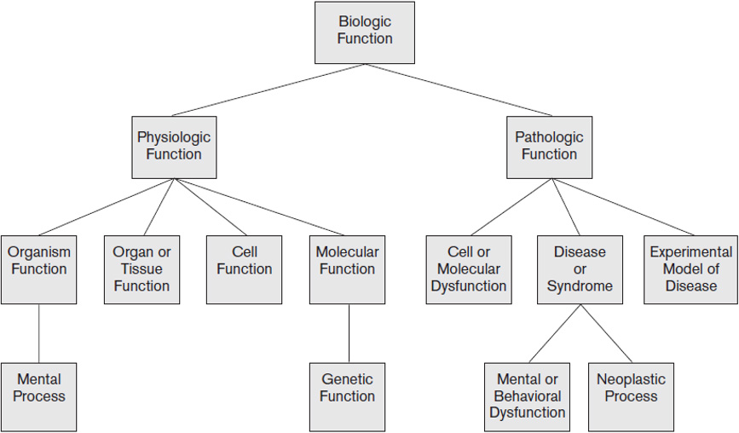
Figure 27.3 A Portion of the U M L S Semantic Network: “Biologic Function” Hierarchy
Source: U M L S Reference Manual, National Library of Medicine

Slide 25
Text Preprocessing (3 of 3)
Other preprocessing steps
Digits
May or may not be removed during preprocessing
Hyphens and punctuation marks
Handled in different ways
Cases
Most search engines use case-insensitive search
Information extraction tasks
Identifying noun phrases, facts, events, people, places, and relationships

Slide 26
27.5 Inverted Indexing (1 of 3)
Inverted index structure
Vocabulary information
Set of distinct query terms in the document set
Document information
Data structure that attaches distinct terms with a list of all documents that contain the term

Slide 27
Inverted Indexing (2 of 3)
Construction of an inverted index
Break documents into vocabulary terms
Tokenizing, cleansing, removing stopwords, stemming, and/or using a thesaurus
Collect document statistics
Store statistics in document lookup table
Invert the document-term stream into a term-document stream
Add additional information such as term frequencies, term positions, and term weights

Slide 28
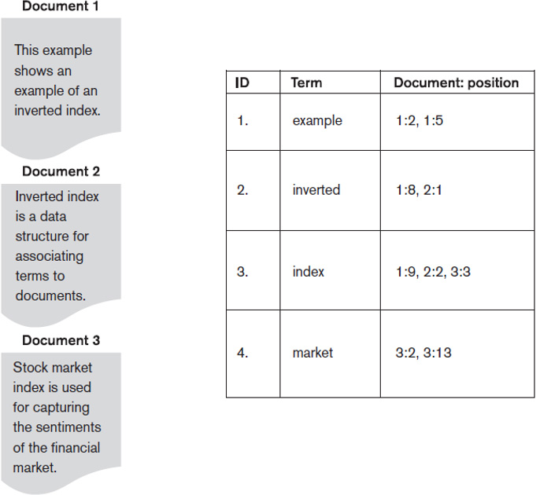
Figure 27.4 Example of an Inverted Index

Slide 29
Inverted Indexing (3 of 3)
Searching for relevant documents from an inverted index
Vocabulary search
Document information retrieval
Manipulation of retrieved information

Slide 30
Introduction to Lucene
Lucene: open source indexing/search engine
Indexing is primary focus
Document composed of set of fields
Chunks of untokenized text
Series of processed lexical units called token streams
Created by tokenization and filtering algorithms
Highly-configurable search A P I
Ease of indexing large, unstructured document collections

Slide 31
27.6 Evaluation Measures of Search Relevance (1 of 4)
Topical relevance
Measures result topic match to query topic
User relevance
Describes ‘goodness’ of retrieved result with regard to user’s information need
Web information retrieval
No binary classification made for relevance or nonrelevance
Ranking of documents

Slide 32
Evaluation Measures of Search Relevance (2 of 4)
Recall
Number of relevant documents retrieved by a search divided by the total number of actually relevant documents existing in the database
Precision
Number of relevant documents retrieved by a search divided by total number of documents retrieved by that search

Slide 33
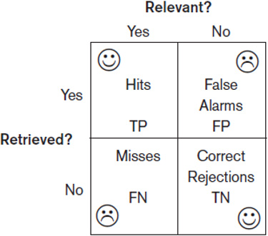
Retrieved Versus Relevant Search Results
T P: true positive
F P: false positive
T N: true negative
F N: false negative
Figure 27.5 Retrieved versus relevant search results

Slide 34
Evaluation Measures of Search Relevance (3 of 4)
Recall can be increased by presenting more results to the user
May decrease the precision
Doc. No. | Rank Position i | Relevant | Precision(i) | Recall(i)
10 | 1 | Yes | 1/1 = 100% | 1/10 = 10%
2 | 2 | Yes | 2/2 = 100% | 2/10 = 20%
3 | 3 | Yes | 3/3 = 100% | 3/10 = 30%
5 | 4 | No | 3/4 = 75% | 3/10 = 30%
17 | 5 | No | 3/5 = 60% | 3/10 = 30%
34 | 6 | No | 3/6 = 50% | 3/10 = 30%
215 | 7 | Yes | 4/7 = 57.1% | 4/10 = 40%
33 | 8 | Yes | 5/8 = 62.5% | 5/10 = 50%
45 | 9 | No | 5/9 = 55.5% | 5/10 = 50%
16 | 10 | Yes | 6/10 = 60% | 6/10 = 60%
Table 27.2 Precision and recall for ranked retrieval

Slide 35
Evaluation Measures of Search Relevance (4 of 4)
Average precision
Computed based on the precision at each relevant document in the ranking
Recall/precision curve
Based on the recall and precision values at each rank position
x-axis is recall and y-axis is precision
F-score
Harmonic mean of the precision (p) and recall (r) values

Slide 36
27.7 Web Search and Analysis (1 of 8)
Search engines must crawl and index Web sites and document collections
Regularly update indexes
Link analysis used to identify page importance
Vertical search engines
Customized topic-specific search engines that crawl and index a specific collection of documents on the Web

Slide 37
Web Search and Analysis (2 of 8)
Metasearch engines
Query different search engines simultaneously and aggregate information
Digital libraries
Collections of electronic resources and services for the delivery of materials in a variety of formats
Web analysis
Applies data analysis techniques to discover and analyze useful information from the Web

Slide 38
Web Search and Analysis (3 of 8)
Goals of Web analysis
Finding relevant information
Personalization of the information
Finding information of social value
Categories of Web analysis
Web structure analysis
Web content analysis
Web usage analysis

Slide 39
Web Search and Analysis (4 of 8)
Web structure analysis
Hyperlink
Destination page
Anchor text
Hub
Authority
PageRank ranking algorithm
Used by Google
Analyzes forward links and backlinks
Highly linked pages are more important

Slide 40
Web Search and Analysis (5 of 8)
Web content analysis tasks
Structured data extraction
Wrapper
Web information integration
Web query interface integration
Schema matching
Ontology-based information integration
Building concept hierarchies
Segmenting web pages and detecting noise

Slide 41
Web Search and Analysis (6 of 8)
Approaches to Web content analysis
Agent-based
Intelligent Web agents
Personalized Web agents
Information filtering/categorization
Database-based
Attempts to organize a Web site as a database
Object Exchange Model
Multilevel database
Web query system

Slide 42
Web Search and Analysis (7 of 8)
Web usage analysis attempts to discover usage patterns from Web data
Preprocessing
Usage, content, structure
Pattern discovery
Statistical analysis, association rules, clustering, classification, sequential patterns, dependency modeling
Pattern analysis
Filter out patterns not of interest

Slide 43
Web Search and Analysis (8 of 8)
Practical applications of Web analysis
Web analytics
Understand and optimize the performance of Web usage
Web spamming
Deliberate activity to promote a page by manipulating search engine results
Web security
Allow design of more robust Web sites
Web crawlers

Slide 44
27.8 Trends in Information Retrieval (1 of 3)
Faceted search
Classifying content
Social search
Collaborative social search
Conversational information access
Intelligent agents perform intent extraction to provide information relevant to a conversation
Probabilistic topic modeling
Automatically organize large collections of documents into relevant themes

Slide 45
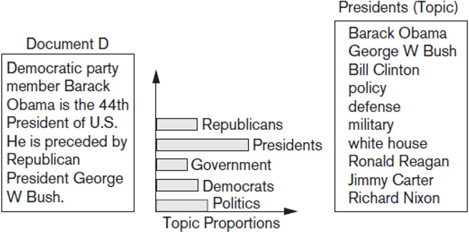
Trends in Information Retrieval (2 of 3)
Figure 27.6 A document D and its topic proportions

Slide 46
Trends in Information Retrieval (3 of 3)
Question-answering systems
Factoid questions
List questions
Definition questions
Opinion questions
Composed of question analysis, query generation, search, candidate answer generation, and answer scoring

Slide 47
27.9 Summary
Information retrieval mainly targeted at unstructured data
Query and browsing modes of interaction
Retrieval models
Boolean, vector space, probabilistic, and semantic
Text preprocessing
Web search
Web ranking
Trends

Slide 48

Copyright

